Slide 1
Software Testing Methodologies
Prashant Joshi

Slide 2
Module 12: Agenda
Module 12: System Testing
Topic 12.1
System Testing- Introduction, Overview & Issues
Topic 12.2
System Testing – Types, Techniques & Strategies
Topic 12.3
Examples

Slide 3
Topic 12.1: System Testing- Introduction, Overview & Issues

Slide 4
System Testing
System testing is concerned with the behaviour of a whole system. The majority of the functional failures should already have been identified during unit and integration testing
System testing is usually considered appropriate for comparing the system to the non-functional system requirements, such as security, speed, accuracy, and reliability. External interfaces to other applications, utilities, hardware devices, or the operating environment are also evaluated at this level.

Slide 5
System Testing
It is essential to define what the “system” is made up of
A system for one team/organisation may mean a module/part of a larger system
Generally system level is treated as closest to everyday experience i.e. system (Product) as seen in the hands of the user
In system testing apart from finding faults the goal is to demonstrate
System works
System is reliable
System is durable
Quality of system for defined parameters
Use of specification based testing techniques to design test cases

Slide 6
System Testing – Aspects
Thread
Thread Possibilities
Thread Definitions
Atomic Thread Function

Slide 7
System Requirements – Basic Concepts
Data
Information used and created by the system
Actions
Transform, data transform, control transform, process, activity, task, method, service
Devices
Source and destination of system level inputs and outputs
Events
System level I/O; occurs on port device; inputs and outputs of actions
Threads
Model of a system – interactions among data, events and action

Slide 8
Software Testing Methodologies
Prashant Joshi

Slide 9
Topic 12.2: System Testing – Types, Techniques & Strategies

Slide 10
Concepts
Relationship among basic concepts
Interrelation among data, actions, devices, events and threads
Modeling with Basic Concepts
Structural
Behavioural
Contextual

Slide 11
Structural Strategies for Thread Testing
Bottom Up Threads
Node and Edge Coverage Metrics

Slide 12
Functional Strategies for Thread Testing
Event-based Thread Testing
Port-based Thread Testing
Data-based Thread Testing

Slide 13
Testing – In action
Process View
Progression Vs. Regression

Slide 14
Test Plan

Slide 15
Test Plan
IEEE Test Plan (Review the paper)
Test Cycles
Test Cases per cycle
Test Execution Report
Test Automation
Test Effort Estimation
Design
Development
Execution

Slide 16
Reliability Analysis
Reliability theory is concerned with determining the probability, that a system, possibly consisting of many components will function.
Overall, System components can be treated in configurations
Series System: System will function if all components are functioning
Parallel System: System will function if one of the component is functioning. (Provided the ultimate aim is to have the same component working).
Composite System: (Series + Parallel) in varying configurations

Slide 17
Reliability Analysis
Each component will function with some known probability (independent of each other)
Upper and lower bounds of probability
A component may show a dynamic behaviour over time i.e. it functions for a random length of time and after which it fails
Amount of time a system functions is related to the distribution of a component lifetimes
In particular, it turns out that if the amount of time that a component functions has an increasing failure rate on average distribution, then so does the distribution of system lifetimes

Slide 18
Reliability Analysis
This study gives us the mean life time of a system
Analysis requires us to look at the system when failed components are subjected to repair
# of defects
Test Cycles

Slide 19
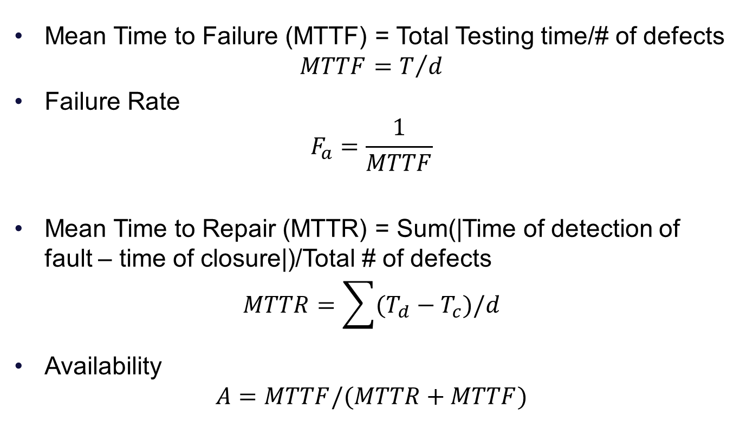
Reliability Analysis
Mean Time to Failure (MTTF) = Total Testing time/# of defects
$$MTTF=T/d$$
Failure Rate
$$F_{a}=\frac{1}{MTTF}$$
Mean Time to Repair (MTTR) = Sum(|Time of detection of fault – time of closure|)/Total # of defects
$$MTTR=\sum{(T_{d}−T_{c})/d}$$
Availability
$$A=MTTF/(MTTR+MTTF)$$

Slide 20
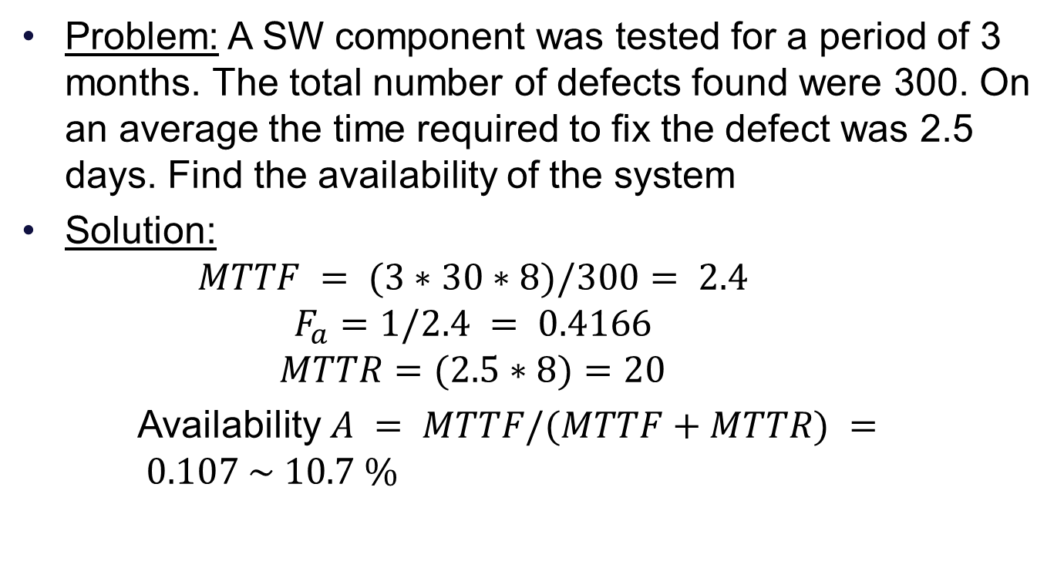
Reliability Analysis
Problem: A SW component was tested for a period of 3 months. The total number of defects found were 300. On an average the time required to fix the defect was 2.5 days. Find the availability of the system
Solution:
$$MTTF = (3∗30∗8)/300= 2.4$$
$$F_{a}=1/2.4 = 0.4166$$
$$MTTR=(2.5∗8)=20$$
Availability $A = MTTF/(MTTF+MTTR) = 0.107 \sim 10.7 \%$

Slide 21
Petri Nets & System Test

Slide 22
Petri Net
Carl Adam Petri 1963
Accepted Model for protocol and other application involving concurrency and distributed processing
Form of directed graph: a bipartite directed graph
A bipartite graph has two sets of nodes V1 and V2 and a set of edges E, with the restriction that every edge has its initial node on one of the sets V1, V2 and its terminal node in the other set
In Petri net one set is Places and the other is Transitions

Slide 23
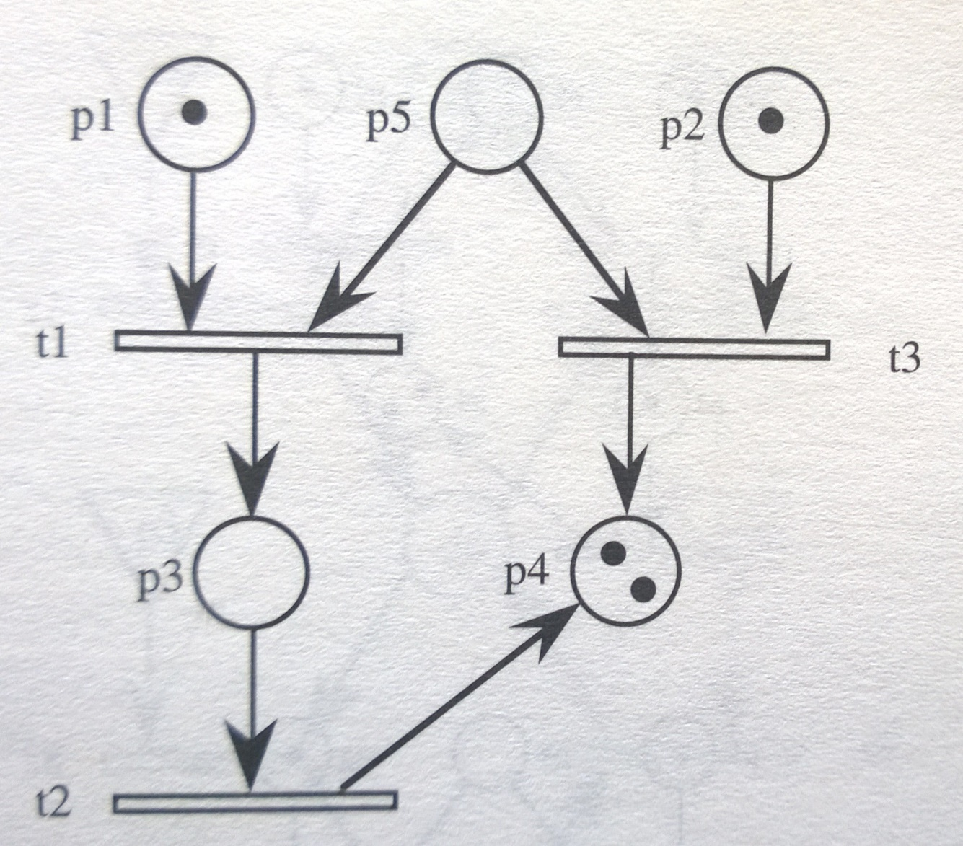
A Marked Petri Net

Slide 24
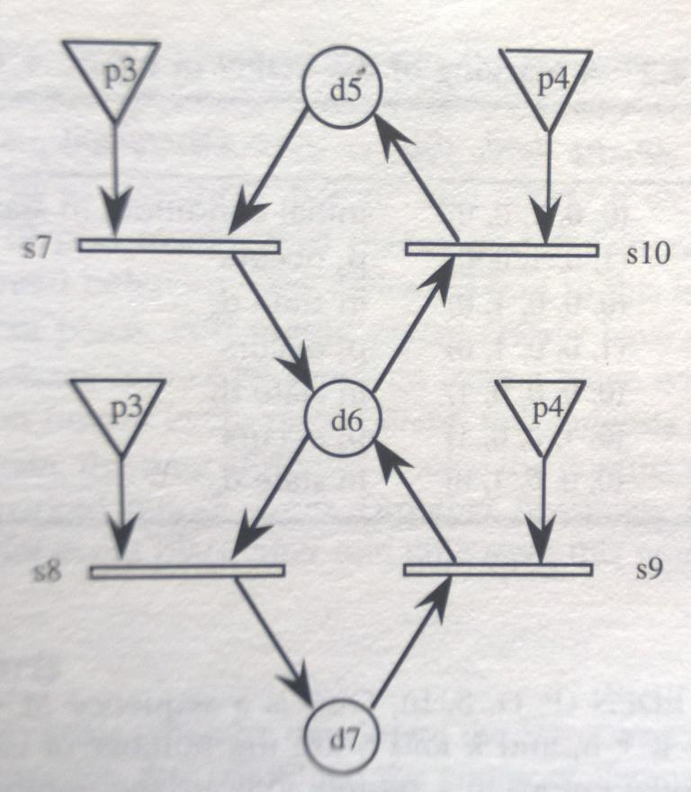
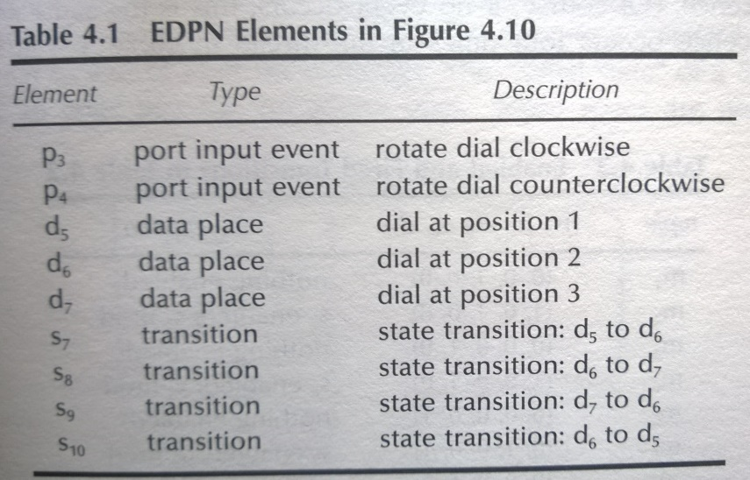
Event Driven Petri Net

Slide 25
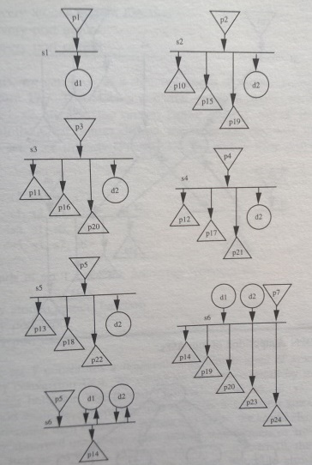
System Testing Currency Converter Program

Slide 26
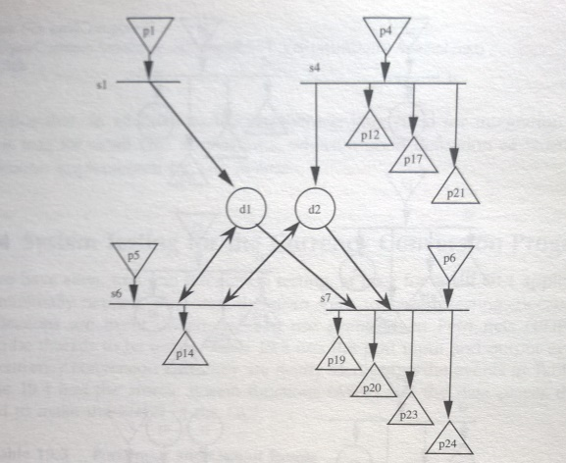
EPDN Composition of Four ASFs

Slide 27
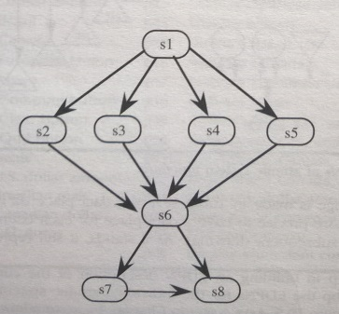
Directed Graph of ASF sequences

Slide 28
Software Testing Methodologies
Prashant Joshi

Slide 29
Topic 12.3: Examples

Slide 30
Automated Teller Machine
ATM System
Terminal I/O
Manage Sessions
Conduct Transactions
Card Entry
PIN Entry
Select Transactions
Source: T1: Figure 12.2

Slide 31
Garage Door
The device controls for opening and closing the door are different for the various product lines. They may include controls from within a home information system. The product architecture for a specific set of controls should be directly derivable from the product line architecture
The processor used in different processes will differ. The product architecture for each specific processor should be directly derivable from the product line architecture
If an obstacle (person or object) is detected by the garage door during descent, it must halt (alternately re-open) within 0.1 second
The garage door opener should be accessible for diagnosis and administration from within the home information system using product specific diagnosis protocol. It should be possible to directly product an architecture that reflects this protocol

Slide 32
Garage Door
User Interface
Diagnosis
Raising/Lowering Door
Obstacle detection
Communication Virtual Machine
Sensor/Actuator Virtual Machine
Scheduler That guarantees deadlines

Slide 33
Building Lighting Control System
Lighting control system for a apartment complex
Emergency lights are UPS powered
Corridor lights are timed and based on ambient light
Garden and Architectural lights are timed

Slide 34
Building Lighting System
User Interface
Local Input
UI
Inputs
Main Control Logic
Communication (Peer 1)
Communication (Peer 2)
Command Receiver and Processor
Configuration
VM for various inputs
Input 1
Input 2
Input 3

Slide 35
Software Testing Methodologies
Prashant Joshi

